Slide 1
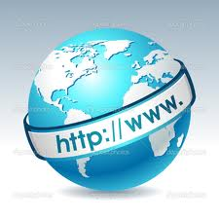


9. INTERNET TECHNOLOGIES
D. Serikbayev East Kazakhstan State Technical University
ICT Spring 2019
Notes:
Welcome to this three-part series on internet technologies! These videos focus on the world wide web, which is one aspect of the internet. In the next several videos, we discuss components of the web, how the internet delivers web data, and languages used on the web.

Slide 2

Copyright Notice
This presentation is presented as is. This presentation was assembled using information from various websites or sources across the web.
This presentation uses Creative Commons Attribution 4.0 International (CC BY 4.0). © 2019 BilimEdtech

Slide 3
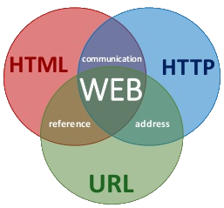
9.1: Web Components
9.1: Web Components
9.2: Web Data Delivery
9.3: Web Languages
Notes:
During part one of this three-part series, we examine different components of the web.

Slide 4
9.1: Learning Objectives
Know how clients and servers interact
Understand the role of Internet Service Providers
Explain the function website hosting services
Describe domain names, URLs, and IP Addresses
State the process of launching a website
Notes:
Please take a moment to read the learning objectives for this video.

Slide 5
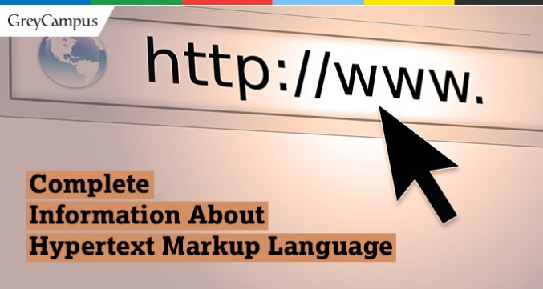
World Wide Web Introduction
The World Wide Web (commonly shortened to the Web) is a system of interlinked documents accessed via the internet
The WWW uses a protocol and language called hypertext
Hypertext is the
interlinking of documents
Notes:
The world wide web is an information system of interlinked documents accessed via the internet. The WWW or the web uses a system centered around hypertext. Hypertext refers to the interlinking of documents. Users can use hyperlinks in HTML documents to navigate between web pages.

Slide 6
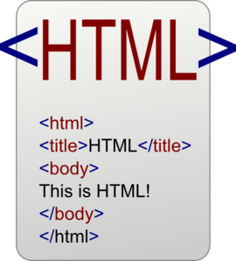
World Wide Web Introduction (2)
Web pages are text files written in a language called hypertext
  We call these HTML files
Files are linked using hyperlinks
HTML files and other web data are transferred over the internet using the Hypertext Transfer Protocol (HTTP)
Notes:
The majority of the documents on the web are web pages that are text files written in a hypertext markup language called HTML files. Web pages may include text, images, audio, video, and other multimedia components. The files are linked using hyperlinks. Hyperlinks in the HTML files might link to other web pages, images, videos, or downloadable files. HTML files and other web data are transferred over the internet using the Hypertext Transfer Protocol, or HTTP.

Slide 7
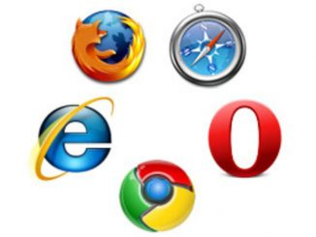
World Wide Web Introduction (3)
A web browser is a software program which interprets the HTML documents and displays it on the user’s screen
Notes:
Users can access the world wide web using a web browser. A web browser is a software program that interprets HTML documents and then displays them on the user’s screen. There are different web browsers, but some popular choices are FireFox, Safari, Chrome, Opera, Edge, or Internet Explorer.

Slide 8
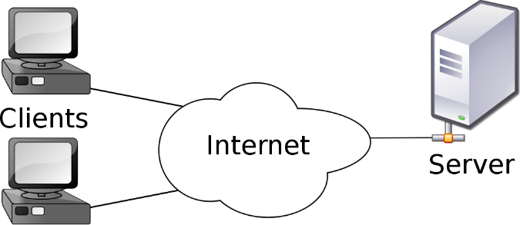
Web Components
Clients and Servers
Internet Service Providers
Website Hosting Services
Domain Names, URLs, and IP Addresses
Domain Registrars
Notes:
The web is a complex system made up of many components. This list of web components also includes elements of the internet. Since the web is an internet service, we’ll include specific internet components that are important to the web. Additionally, it is not practical to discuss the web without discussing parts of the internet. The first important component of the web and internet are clients and servers.

Slide 9
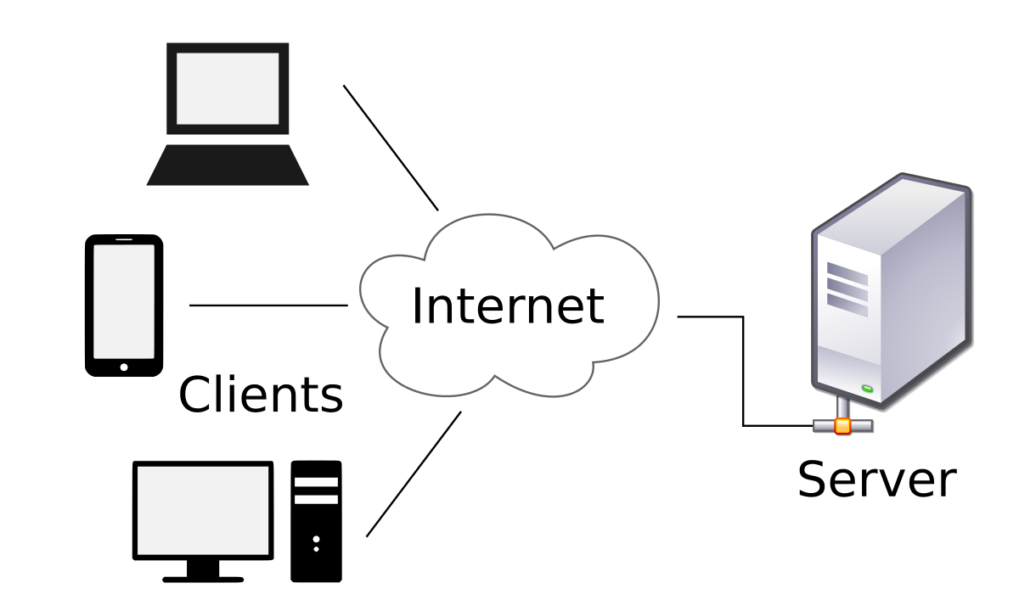
Clients & Servers
An essential part of the internet are clients are servers
Client-Server model
  Clients request information
  from a server
  The server responds to
  the request
Notes:
Clients and servers are an important part of the internet since the world wide web architecture uses the client-server model. The two work hand-in-hand. A client requests information from a server. The server responds to requests for information and then sends the results to the client. A server can accept requests from any number of clients, and even become a client and request information from another server.

Slide 10





Clients & Servers (3)
Clients (Browser)
  Internet Explorer
  Chrome
  Firefox
  Opera
Servers
  Apache
  Microsoft IIS
  Tomcat
  Nginx
Notes:
A typical web-based client is a software application called a web browser, such as Firefox, Chrome, or Internet Explorer. Web browsers request web data from web servers using HTTP. Examples of web servers are Apache, Microsoft IIS, Tomcat, and Nginx. The job of the web server is to return HTML files and other web data to the client.

Slide 11
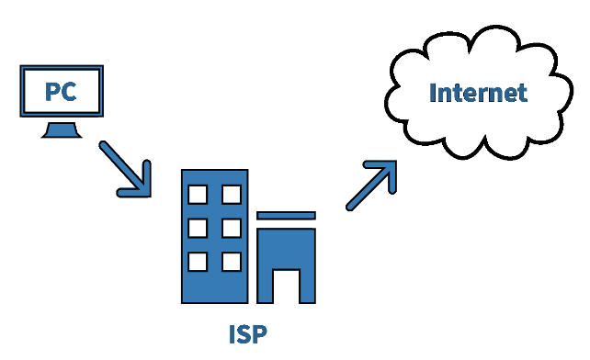
Web Components
Clients and Servers
Internet Service Providers
Website Hosting Services
Domain Names, URLs, and IP Addresses
Domain Registrars
Notes:
Internet service providers, or ISPs, play a critical role in accessing web data. The job of an ISP is to connect clients to the internet.

Slide 12
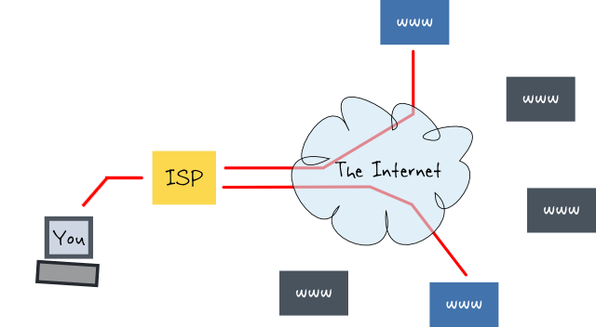
Internet Service Providers (ISP)
Connects clients to the internet
  Businesses (Fiber optic)
  Home users (DSL line)
  Personal users (mobile data)
Good ISPs
  high uptime
  fast download and upload speeds
  charge a fair price
Notes:
There are different types and classes of ISPs. Some ISPs provide internet access to large businesses, and others provide access to the home users. Your mobile network provider is an ISP since they provide you with on-demand internet access to your smartphone. ISPs should be reliable and have high uptime, meaning they always allow a connection to the internet. ISPs should offer fast download and upload speeds. Finally, ISPs should charge a fair price for the service.

Slide 13
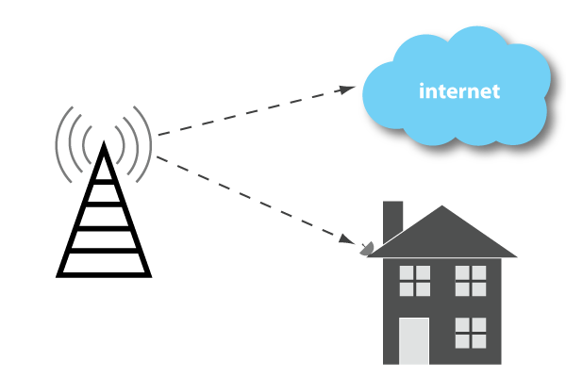
Internet Service Providers (ISP) (2)
Wired ISPs
  KazakhTelecom
  AlmaTV
Wireless ISPs
  Kcell / Activ
  Beeline
Notes:
ISPs connect clients to the internet using wired or wireless media. Wired ISPs use fiber optics or copper cable. Examples of wired ISPs are KazkhTelecom and AlmaTV. Wireless ISPs, such as Kcell and Beeline, connect mobile clients using radio waves.

Slide 14

Web Components
Clients and Servers
Internet Service Providers
Website Hosting Services
Domain Names, URLs, and IP Addresses
Domain Registrars
Notes:
Another essential component of the web is website hosting services.

Slide 15

Web Hosting Services
Connects websites to the internet
Provides a wide range of services required to host a website
  Simple web hosting
  Web hosting + other services
Notes:
Web hosting services provide the essential service of connecting websites to the internet. They provide a broad range of services required to host a website. The simple web hosting service providers, or web hosters, give users a place to upload their HTML files. Advanced service providers offer web hosting, other services, such as email and DNS, or they allow a user full access to a virtual server.

Slide 16
Web Hosting Services (2)
Networking services
  Routers
  Bandwidth / connection to internet
  Firewall hardware and software
Web server
Email server
Disk space
IT services
  (Backups, maintenance)
Notes:
Web hosters provide the networking services required to connect the website and server to the internet. They provide the networking hardware and connect to an ISP with high bandwidth. They provide network security through firewalls to keep out intruders and hackers. The hosting providers configure the servers with the required software, such as with web server and email server software. They allocate sufficient disk space for the web files. Additionally, they provide IT services to backup the web data and maintain the servers.

Slide 17
Web Hosting Services (3)
Simple Web Hosting
  HostGator
  1&1 Web Hosting
  GoDaddy
Infrastructure Hosting
  Amazon Web Services
  Google Cloud Platform
  Microsoft Azure
Notes:
Examples of simple and low-cost web hosting providers are HostGator, 1&1 Web Hosting, and GoDaddy. Infrastructure hosting companies that offer complex services are Amazon AWS, Google Cloud, and Microsoft Azure.

Slide 18
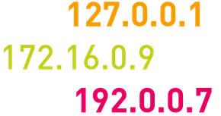
Web Components
Clients and Servers
Internet Service Providers
Website Hosting Services
Domain Names, URLs, and IP Addresses
Domain Registrars
Notes:
You have probably heard about domain names, URLs, and IP addresses, so what are they?

Slide 19
Domains, URLs, and IP Addresses
Domain name: The unique name of a computer on the internet
  microsoft.com
Uniform Resource Locator (URL):
  http://www.microsoft.com/faqs.html
Internet protocol (IP) address: Unique address of a computer on a network
  192.168.1.1
Notes:
A domain name is a unique name of a computer on the internet, such as microsoft.com. A Uniform Resource Locator, or URL, is the exact location of a document on the web that combines the protocol, domain name, and the HTML file name. An IP address is a unique address of a computer on a network, such as 192.168.1.1.

Slide 20
IP Addresses
The internet needs addresses to identify different nodes
  Similar to how every building in the city has an address
An address used by the Internet Protocol is called an IP address
Every host on the internet has a unique IP address, made up of four numbers
  E.g.. 192.168.10.254, each number is between 0 and 255
Notes:
Before the node or router can deliver the data, it needs to know where to go. The internet needs an addressing system. Addressing systems are familiar, such as how buildings and streets in a city have an address. The addresses used by the internet protocol are called IP addresses. Every host on the internet has a unique IP address that is made up of four numbers that range from 0 to 255. An example of an IP address is 192.168.10.254. Just as a mailing address tells the postal system where to send the AliExpress package, IP addresses tell the internet protocol where to send the data.

Slide 21
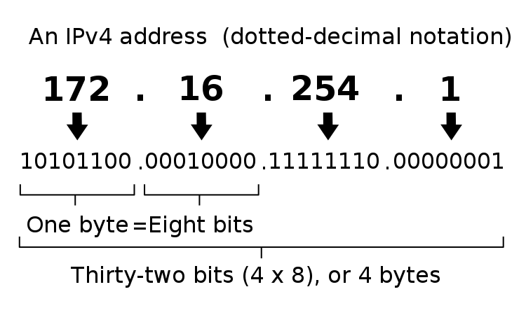
IP Addresses version 4
Approximately 4.3 billion IPv4 addresses
IPv4 ran out of addresses in 2015
Limited connecting new clients
Notes:
There are several versions of IP addresses.
The most common version is IPv4, which allowed for almost 4.3 billion internet hosts.
However, in 2015 the world ran out of IPv4 addresses! This problem meant that ISPs could no longer connect new clients, such as smartphone users.
To alleviate this limitation, IPv6 was created using hexadecimal.
There are approximately 2^125 th power, or 340 undecillion IPv6 addresses.
Just how big is this number? One researcher estimates that it would take 69,000 years to scan all the IPv6 addresses if they were scanning one million addresses per second.
The bottom line is that the world will not run out of IP addresses for a very long time!

Slide 22
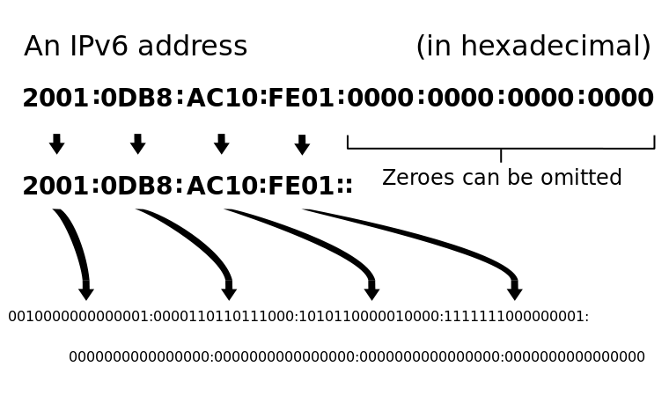
IP Addresses version 6
IPv6 uses hexadecimal
2^125, or 340 undecillion addresses
69,000 years to scan all the IPv6 addresses scanning one million addresses per second
Notes:
There are several versions of IP addresses.
The most common version is IPv4, which allowed for almost 4.3 billion internet hosts.
However, in 2015 the world ran out of IPv4 addresses! This problem meant that ISPs could no longer connect new clients, such as smartphone users.
To alleviate this limitation, IPv6 was created using hexadecimal.
There are approximately 2^125 th power, or 340 undecillion IPv6 addresses.
Just how big is this number? One researcher estimates that it would take 69,000 years to scan all the IPv6 addresses if they were scanning one million addresses per second.
The bottom line is that the world will not run out of IP addresses for a very long time!

Slide 23
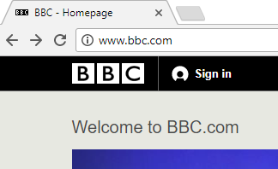
Domain Names
The numbers in an IP address are
hard to remember, while names
are easier to remember
A domain name is a unique name
that identifies a website
Domain Name System (DNS)
  a mapping between the human-readable name of a host and its IP address
Notes:
Computers and humans use different languages. Computers use numbers, while we use words. IP addresses are hard to remember. The way routers on the internet know how to get to a website is through the IP address. The internet users do not need to know the actual IP address, but the domain name that corresponds to the address. For example, the BBC News website has an IP address of 212.58.244.67. However, a web user only needs to remember the domain name of bbc.com to access the news site. A domain name is a unique name that identifies a website. The domain name system, or DNS, does the conversion for us. DNS creates a map between the human-readable name of a host and its IP address. When we type bbc.com in the address bar of the browser, DNS looks up the name and tells the router to go to that IP address.

Slide 24
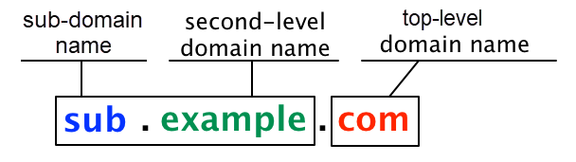
Domain Names (2)
A domain name consists of two or more parts
  google.com
  do.ektu.kz
Notes:
A domain name consists of two or more parts, such as google.com or do.ektu.kz. The rightmost label is the top-level domain, which is .com or .kz in this example. The next part is the primary domain name, such as google or ektu. However, we typically refer to domain names with the primary domain and TLD, such as google.com or ektu.kz. Every domain name can contain subdomain names. A domain name tells the user and the system the order and hierarchy of the network’s domain. Using do.ektu.kz as an example, we know that that the do subdomain is part of the ektu.kz domain.

Slide 25
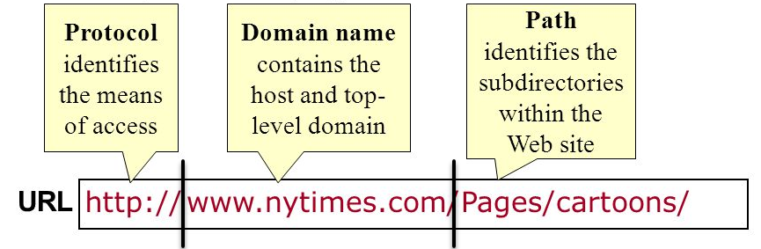
URL
A URL is the complete address of a web page
Every page has a unique URL
Notes:
Web browsers know to locate the data on the web using a URL, or a uniform resource locator. A URL contains the complete address of a website or webpage. Every webpage has a unique URL. The first part of the URL is the protocol. Web data typically uses HTTP or HTTPS. The next part contains the complete domain name. The last part of the URL is the specific name of the document or folder on the web server.

Slide 26
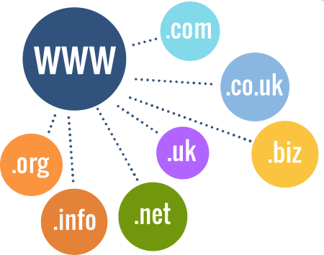
Web Components
Clients and Servers
Internet Service Providers
Website Hosting Services
Domain Names, URLs, and IP Addresses
Domain Registrars
Notes:
A final component remains. How does someone get a domain name? Registrars provide this service and allow users to acquire domain names.

Slide 27
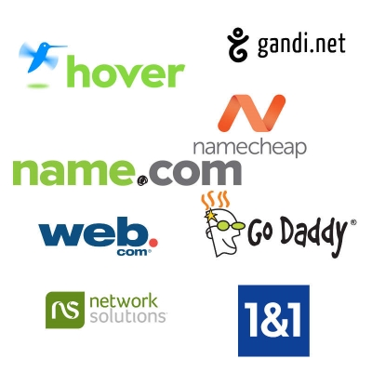
Domain Registrar
A company that provides domain name registration services for a fee
Maintain databases that map domain names to IP addresses
Send the domain information to DNS for lookup
Notes:
A domain registrar is a company that provides domain name registration services for a fee. These companies maintain databases that map domain names to IP addresses. They also send the new domain name and IP address information to DNS servers.

Slide 28
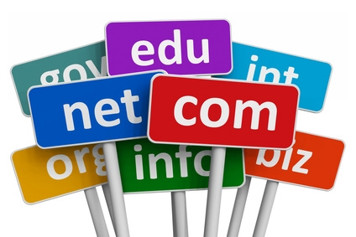
Launching a Website
Choose a domain name
Register with a domain registrar
Choose a hosting service
Tell the registrar the IP address
Upload the web content to the web server
Notes:
Registrars are important if you want to launch a website. The first step is to choose a domain name and then register it with a domain registrar. You would then need to select a hosting service and get the IP address of your new website. You would have to inform the registrar of this IP address so they can tie it to your domain name. After you create your web content using HTML, you would then publish or upload the files to the web server.

Slide 29
Web Components Summary
The web uses a client-server architecture
Internet Service Providers connect clients to the internet
Web hosting services connect websites to the internet
A domain name is the unique name of a computer on the internet
A URL provides the exact address of a specific web page
An IP address is the unique address of a computer on a network
Domain registrars allow users to acquire domain names
Notes:
In summary, the world wide web is made up of many components. We examined a few of these elements. First, the web operates in a client-server architecture. Clients, such as web browsers, request information from web servers. Next, we described the role of internet service providers, which connect clients to the internet. Third, we explained the function of website hosting services and how they connect websites to the internet. Next, we looked at how domain names, URLs, and IP addresses function. A domain name is the unique name of a computer on the internet. A URL provides the exact address of a specific web page. An IP address is the unique address of a computer on a network. Finally, we described the process of launching a website and the role that a domain registrar plays in allowing a user to acquire a domain name.

Slide 30
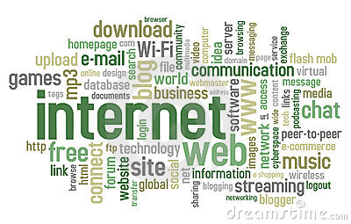
9.2: Web Data Delivery
9.1: Web Components
9.2: Web Data Delivery
9.3: Web Languages
Notes:
During part one of this three-part series, we examined the various components of the web. This video describes how web data moves across the internet.

Slide 31
9.2: Learning Objectives
Describe what happens when you access a web page
List the protocols uses to move web data
State the limitation of IP
Describe the importance of TCP
Explain how TCP/IP moves data across the internet
Notes:
Please take a moment to read the learning objectives for this video

Slide 32

How does the internet work?
What happens when you visit a web page?
Or send an email?
How does the data know to get
from your computer to the server
or from the server to your computer?
Notes:
The internet and web are technologies that we use and take for granted. We probably do not understand how they work. For example, what happens when you visit a webpage? Or when you send an email? How does the data know to get from your computer to the server or from the server to your computer? This presentation will help answer these questions.

Slide 33
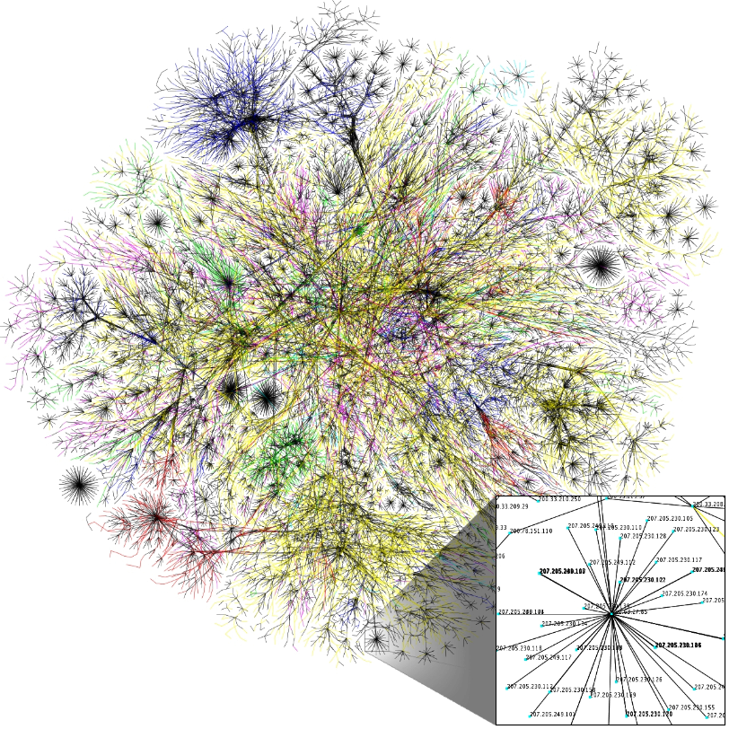
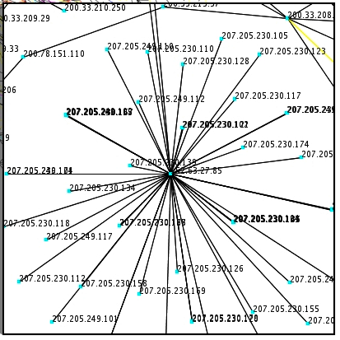
A Visualization of Internet from 2006
Notes:
This visualization of the internet from 2006 shows its complexity. Let’s say that you are in the purple at the top of this map, and the website you want to visit is all the way at the bottom. There are a lot of different paths that the data can take and a lot of chances for the data to get lost along the way.

Slide 34
Internet, Packets, and Routing
Internet - is a network of computer networks
Routers - transmit data in packets using the Internet Protocol (IP)
Packet – a unit of packaged information
Routing – process of moving packets from one node (computer device) to another
Notes:
To recap from a previous lecture, the internet is a network of many networks. Routers transmit data in packets using the internet protocol. A packet is a package of a small amount of information. The router's job is to move packets from one node to another node.

Slide 35
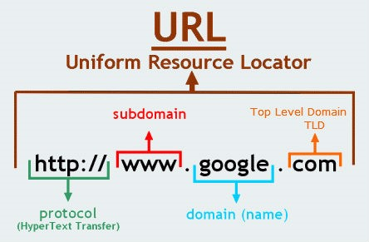
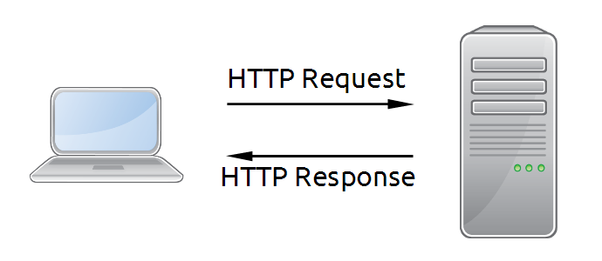
Sending/Receiving Data: HTTP
A client initiates an HTTP request
The server sends a response along with data
Notes:
Let’s examine how data moves across the internet when a user enters a URL in the web browser. First, we should note that the web browser and web server are both on the application layer and communicate using HTTP, or the hypertext transfer protocol. The web browser initiates the process by making an HTTP request to a server based on the information in the URL. The URL contains the protocol, the domain name, and specific file to retrieve. The server processes the request and then sends back a response, which includes the requested data.

Slide 36
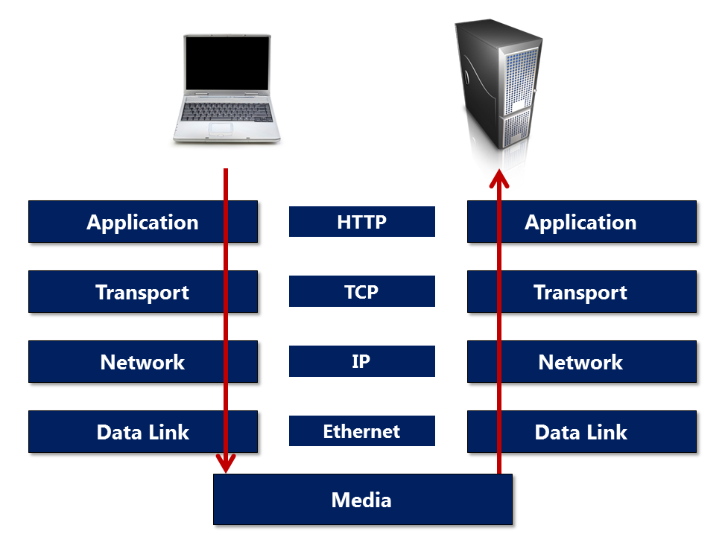
Sending/Receiving Data: HTTP (2)
Notes:
Let’s break down the process and refer back to the network model. The application layer where the web browser and web server reside initiates the chain of events starting with the HTTP request. The application sends the HTTP request to the TCP network process on the transport layer, which then uses IP to transmit the data across the internet. On the receiving end, the server reverses the process.

Slide 37
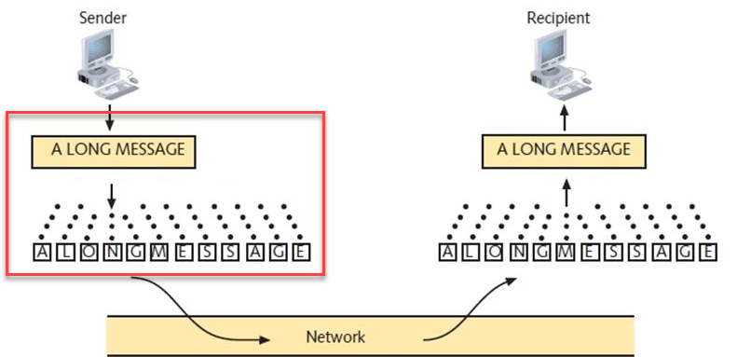
Sending/Receiving Data: TCP
At the sender, TCP divides data into packets and sent to the nearest node (router)
Notes:
When the TCP network process receives the HTTP request, it has some work to do before it can start transferring the file. TCP must transmit the data piece by piece because the internet moves data in small packets. For example, if you want to send a 5-megabyte picture to your friend, your file will be sent in over 3000 individual packets! The network transport process will grab piece after piece of the file and send the data to the nearest router using IP until it has sent the entire file.

Slide 38
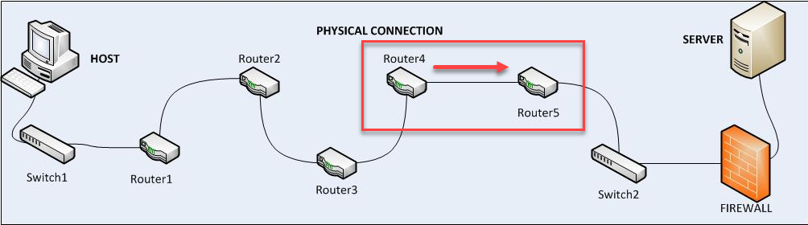
Sending/Receiving Data: IP
Each router sends the packet to another router that is closer to the final destination
Notes:
Each router sends the packet using the internet protocol to the next router to move the data to the final destination. Routing is a complicated process. A router does not need to know the full route or map to send the data. The router only needs to know the next hop or destination. By examining the address of the final destination, the router determines where to send it next. The 3000+ packets from your 5MB picture might take many different routes and arrive at the receiver at different times. It is even possible that some of the packets get lost along the way.

Slide 39
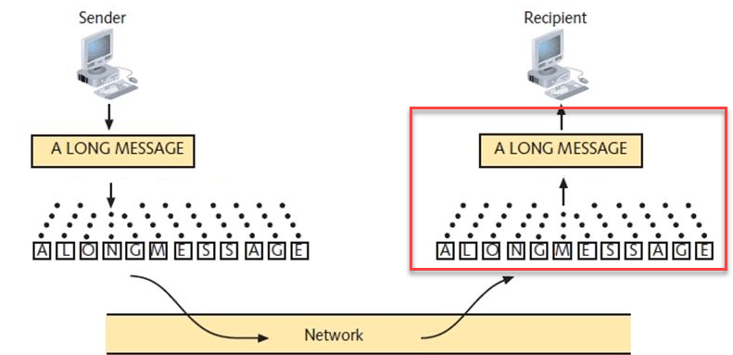
Sending/Receiving Data: TCP (2)
At the receiver, TCP reassembles the packets to get the original data
Notes:
At the receiving end, the TCP network process reassembles the incoming packets to get the original data. Once completed, the file is guaranteed to be an exact copy of the file that was sent. Earlier, we said that data might get lost or arrive at different times. This potential problem is a limitation of IP. TCP accounts for lost data.

Slide 40
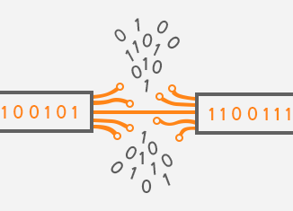
IP Limitations
IP moves packets from one router to another
IP doesn’t check whether packets are delivered successfully
Notes:
The internet protocol is designed to move packets from one router to another and make sure the data on the internet gets to the right place. However, IP does not know or care if the data was successfully delivered to the final destination. So then, how does the receiver know if all of the data arrived or if some data became corrupted along the way? How do we know that the file is a replica of the original?

Slide 41
TCP/IP
TCP/IP = Transmission Control Protocol / Internet Protocol
A method of moving data across the internet with guaranteed delivery of the data
  IP moves the data across the internet
  TCP ensures that all of the data arrives intact
Notes:
The Transmission Control Protocol, or TCP, is one of the primary protocols used on the internet. The term is commonly referred to as TCP/IP. In simple terms, TCP/IP is a method of moving data across the internet with the guarantee of data delivery. The role of IP is to move the data across the internet and deliver it to the final destination. TCP makes sure the data arrives intact and then reassembles the data exactly as it was transmitted.

Slide 42
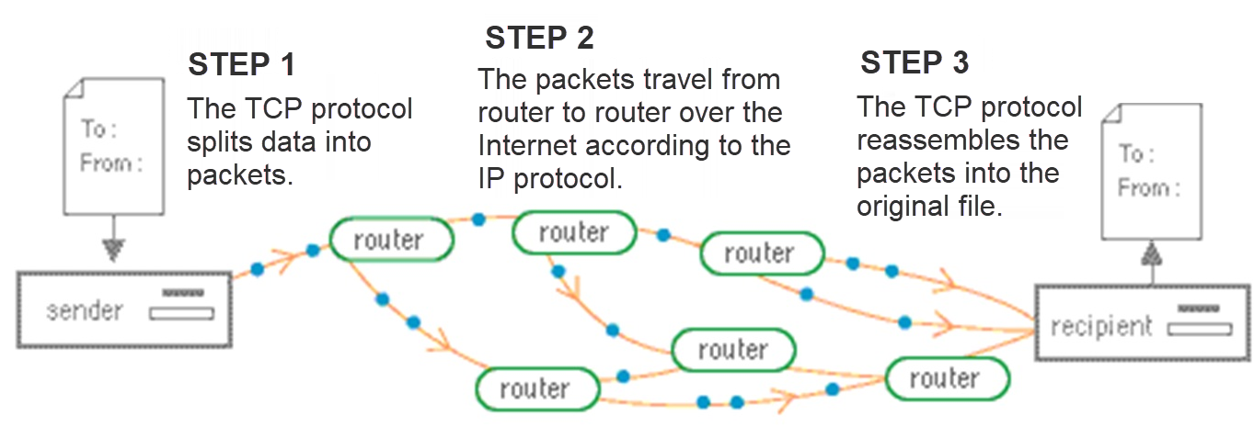
TCP/IP (2)
Notes:
This diagram shows the TCP/IP process. First, TCP splits the data into small packets and then passes the packets to the internet protocol for transmission. Next, the packets travel from router to router over the internet taking different paths before they arrive at their final destination. Finally, TCP reassembles the small packets in the correct order. If any information is missing or corrupt, TCP sends a request back to the sender for that particular packet.

Slide 43
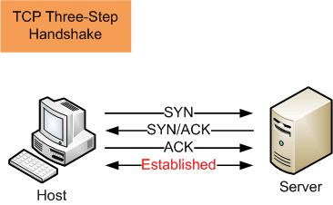
TCP/IP Process
Creates end-to-end virtual connections
Uses a three-step handshake to establish connection
Sends the data using IP
Notes:
Before transmitting data, TCP creates a connection between the source and destination nodes and keeps the connection established until the data finishes transferring. TCP uses a three-step handshake to establish the connection. Once the connection is created, TCP breaks large data into smaller packets and uses IP to deliver the data. On the receiving end, TCP ensures that the data arrives intact and then assembles it to create a duplicate of the original file.

Slide 44
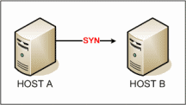
TCP/IP Process (2)
First: The client sends a request to the server to establish a connection
Notes:
When TCP wants to create a connection with a remote host:
the first thing the client does is send a request to the server to establish a connection.

Slide 45
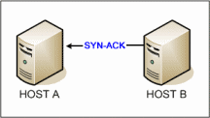
TCP/IP Process (3)
Second: The server receives the request and responds back with acknowledgment to the request
Notes:
When TCP wants to create a connection with a remote host:
the first thing the client does is send a request to the server to establish a connection.
Next, the server receives the request and responds back with an acknowledgment of the request.

Slide 46
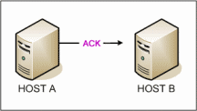
TCP/IP Process (4)
Third: The client knows the server accepted it, so it sends an acknowledgment back to the server
Notes:
When TCP wants to create a connection with a remote host:
the first thing the client does is send a request to the server to establish a connection.
Next, the server receives the request and responds back with an acknowledgment of the request.
Finally, the client sees that the server accepted the request for a connection, so the client sends an acknowledgment of the server’s response back to the server.

Slide 47
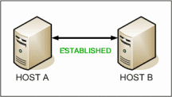
TCP/IP Process (5)
Finally: The connection is established
The client can send the data to the server
Notes:
When TCP wants to create a connection with a remote host:
the first thing the client does is send a request to the server to establish a connection.
Next, the server receives the request and responds back with an acknowledgment of the request.
Finally, the client sees that the server accepted the request for a connection, so the client sends an acknowledgment of the server’s response back to the server.
At this stage, the client and server established a virtual connection.
The client can then start transferring the data to the server.

Slide 48
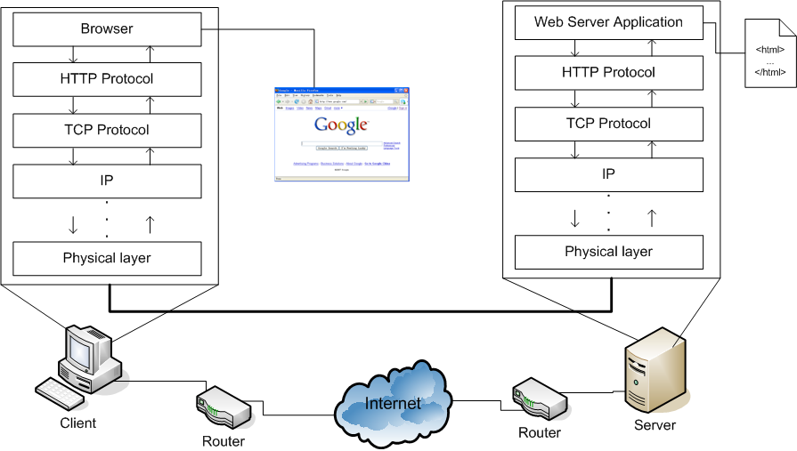
Putting it All Together
Notes:
This diagram shows the process of what takes place when you visit a web page. The process works the same for sending or receiving data. The client could send data to the server, or the server could send data to the user. First, you type a URL in your web browser. The browser initiates an HTTP request based on the domain name in the URL. The client then performs a DNS lookup of the domain name to get the IP address. HTTP then uses TCP to establish a connection to the remote server. Once the client creates a virtual connection with the server, TCP splits the data into smaller packets. IP then sends the packets of data through the internet to the host server. On the remote host, TCP assembles the data and gives the HTTP request to the web server application. The web server interprets the HTTP request and gets the HTML file to return to the client. Since the virtual connection still exists, TCP can start sending the data using IP to carry the packets to the client. As the client receives the packets, TCP begins reassembling the HTML file and checking for missing or corrupt packets. TCP then gives the replicated file to the browser using HTTP. The browser then displays the HTML data to the user.

Slide 49
Data Delivery Summary
Web browser makes an HTTP request
The TCP/IP internet protocol stack delivers the data
  TCP creates a virtual connection
  TCP splits the data into small packets and guarantees data delivery.
  IP carry the data to the final destination
  TCP reassembles the data to create a replica of the file
Notes:
In summary, we looked at how data moves across the internet when a user visits a website. First, the web browser makes a request to the server for the web data using HTTP, which then uses TCP/IP to transport the data to the server. TCP initiates a virtual connection with the server using a three-step handshake. TCP then splits the data into smaller packets that IP delivers to the web server. As the data arrives, TCP reassembles the data creating a replica of the original file. Since IP does not check if the data was successfully delivered, TCP provides error checking and guarantees that the data arrives without errors. If any packets are missing or contain corrupted data, TCP requests those specific packets from the sender.

Slide 50
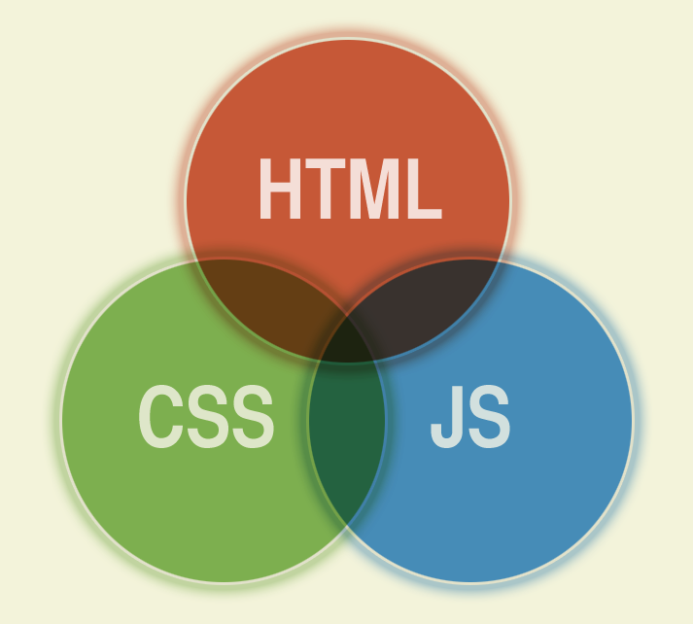
9.3: Web Languages
9.1: Web Components
9.2: Web Data Delivery
9.3: Web Languages
Notes:
This video provides an overview of the primary languages used on the web

Slide 51
9.3: Learning Objectives
List the three main web language
State the primary purpose of the web languages
Describe the purpose HTML
Describe the purpose of CSS
Describe the purpose of JavaScript
Notes:
Please take a moment to read the learning objectives for this video.

Slide 52
Web Languages
The web uses many languages
  Main languages are HTML, CSS, and JavaScript
Two primary purposes
  Displays content to the user
  Allows the user to interact with web data
Notes:
The web uses many languages, but the main languages used in the web browser are HTML, CSS, and JavaScript. The primary purpose of the web languages is to display content to the user and allow the user to interact with web data shown in the browser.

Slide 53
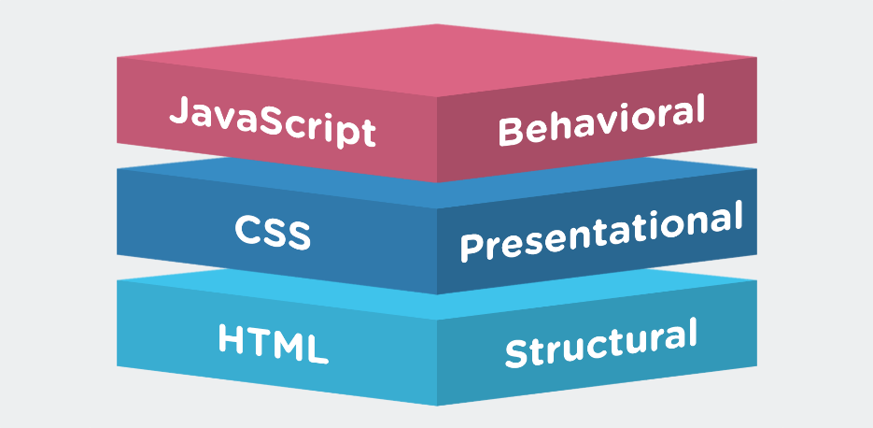
Web Page Components
Content and structure
  HTML
Presentation
  CSS
Behavior
  JavaScript
Notes:
Web pages divide into three separate parts and languages. First, HTML provides the content and structure. The HTML determines the text you read on the webpage and its order. Next, CSS defines the presentation and style of the web page, such as color and font size. Finally, JavaScript controls the behavior of the web page and allows users to interact with the web data. All most all web language focus on or create HTML, CSS, and JavaScript for the web browser to use.

Slide 54
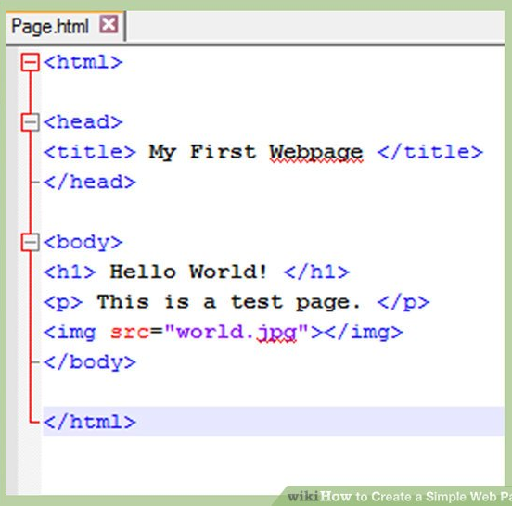
What is HTML?
Purpose: HTML contains the content of a web page
An HTML file is a file that contains HTML content
HTML is the most widely used language to write web pages
Notes:
HTML contains the content of a web page in text format. An HTML file is a file that contains HTML content. The code sample is of a simple HTML file. HTML is important because it is the language most widely used for writing web pages.

Slide 55
What is HTML? (2)
HTML stands for Hypertext Markup Language
  Hypertext
  Markup language
Notes:
HTML is an acronym for Hypertext Markup Language. Let’s unpack the words hypertext and markup language to help us understand HTML.

Slide 56
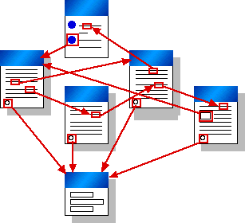
What is HTML? (3)
Hypertext is text that links to other information, or to other web pages
  The links available on a web page are called hyperlinks
Notes:
The word hypertext of the HTML acronym refers to text that links to other information, or to other web pages. The links available on a webpage are called hyperlinks. So, HTML files link to other HTML files.

Slide 57
What is HTML? (4)
HTML is a Markup Language
  A developer uses HTML to "markup" a text document with tags that tells a web browser how to structure the page and display the content
Notes:
HTML is a markup language. A markup language is a computer language that uses tags to define elements within a document. A developer uses HTML to "markup" a text document with tags. These tags tell a web browser how to structure the page and display the content. In the sample HTML code, you can distinguish the content from the HTML tags. Hello World! is some text to display in the web browser. The markup language tells the browser to interpret the text as an <h1> heading tag.

Slide 58
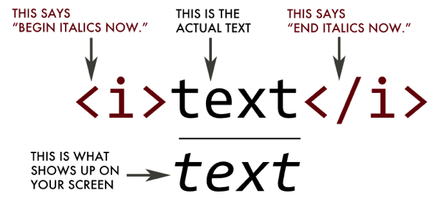
HTML Tags
HTML uses tags to define the structure of the web page
  The content goes inside of the tabs
HTML tags are enclosed within angle brackets
Notes:
The purpose of HTML tags is to provide the structure of the web page. The content goes inside of the tags, or you can look at it as tags surrounding the content. These tags are enclosed within angle brackets, angle bracket <Tag Name> angle bracket. For example, putting <i> in the angle brackets around the text tells the web browser to display the text as italicized.

Slide 59
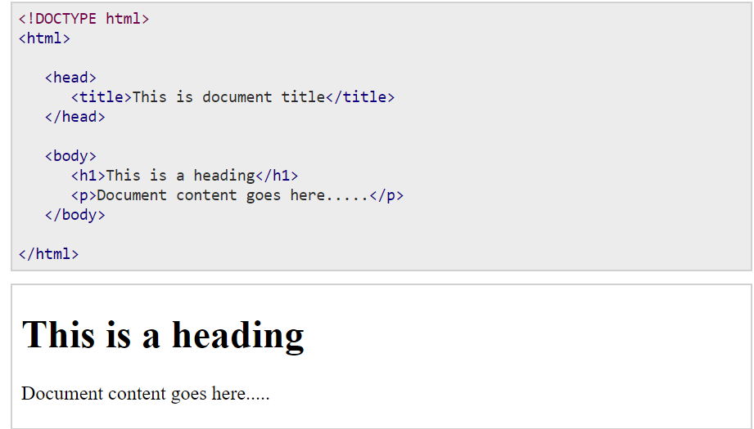
HTML Example
HTML
Display in
a web page
Notes:
Here is an example of an HTML file and rendered HTML in a web browser. Notice that the browser displayed the text in the <h1> tag as a heading.

Slide 60
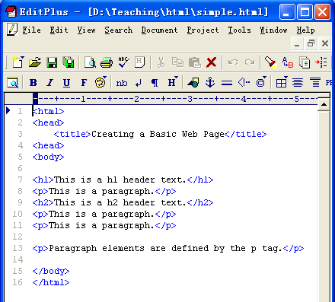
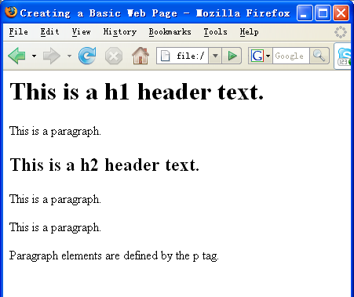
HTML Example (2)
Notes:
This second example shows different headings and paragraphs. Perhaps you noticed that the title is not displayed. The web browser will use the text in the <title> tag in the title of the web browser or tab.

Slide 61
Web Page Components
Content and structure
  HTML
Presentation
  CSS
Behavior
  JavaScript
Notes:
The presentation layer is the second major component of web pages, which CSS defines.

Slide 62
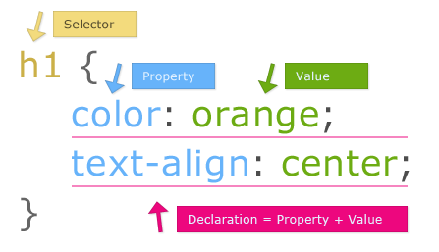
What is CSS?
Purpose: Cascading Style Sheets (CSS) is used to control the style of a web document simply and quickly
Notes:
CSS stands for Cascading Style Sheets, which is used to define the style of a web document simply and quickly.

Slide 63
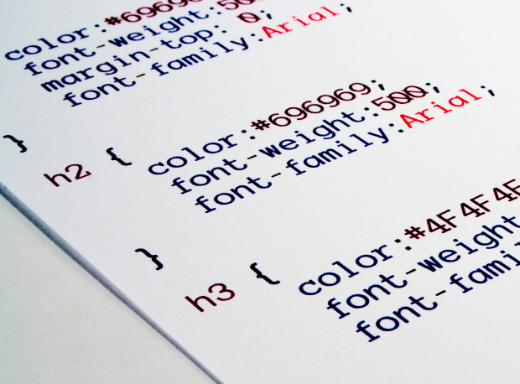
What is CSS? (2)
CSS defines the look and feel part of a web page
  HTML provides the content and structure
  CSS adds styles to HTML tags,
  such as color, text decoration,
  font styles and size,
  and many more features
Notes:
CSS handles the look and feel part of a web page. We just looked at how HTML provides the content and structure using HTML tags. CSS adds styles to HTML tags, such as color, text decoration, font styles, font sizes, and many more features.

Slide 64
How does CSS Work?
CSS styles provide powerful control over the presentation of web pages by styling individual tags
One style can apply to all tags!
  h1 { color: red; }
  By adding the above style, the web browser displays all <h1> (heading 1) tags as red
Notes:
CSS styles provide powerful control over the presentation of web pages by styling individual tags. For example, a single style can apply to all tags! By creating a CSS rule for changing the color of h1 to red, the web browser will display all text inside of the <h1> tags as red. A designer can quickly and easily change the look and feel of a website using CSS.

Slide 65
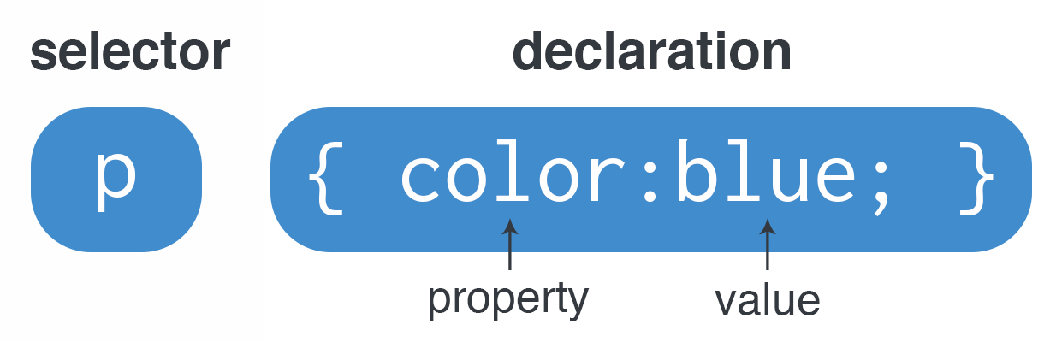
Basic CSS Syntax
CSS Syntax
  selector { property: value; }
Selector: The HTML tag to style (i.e. <p>)
Declaration: The properties and values
  Property: The type of style to apply (i.e. color)
  Value: The value to assign to the property (i.e. blue)
Notes:
The basic CSS syntax uses a selector and then the declaration. The selector is the HTML tag or tags to style. The declaration contains the property and value. The property is the type of style to apply, and the value gets assigned to the property. We can read this example as styling all p tags the color of blue.

Slide 66
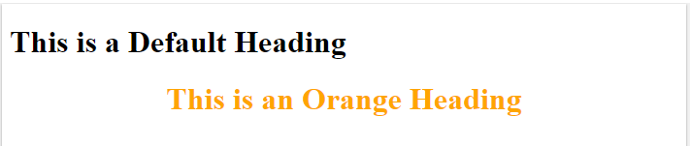
Style Sheet Syntax
This rule styles the <h1> tag in orange and centered
Result:
Notes:
This CSS rule styles all h1 tags the color of orange and aligns the text in the center of the page.

Slide 67
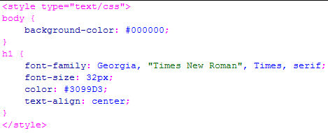
Style Sheet Syntax (2)
selector
property
value
rule
Notes:
Here is another look at a stylesheet with multiple CSS rules. These CSS rules provide styles to the body and h1 tags.

Slide 68
Web Page Components
Content and structure
  HTML
Presentation
  CSS
Behavior
  JavaScript
Notes:
The final component of a web page is the behavior, which JavaScript controls.

Slide 69
What is JavaScript?
Purpose: JavaScript allows a user to interact with a web page
JavaScript is a programming language that allows web pages to do complex things
  Automatically updating content, playing media, showing the current time, etc.
Notes:
JavaScript allows a user to interact with a web page. JavaScript is a programming language that allows web pages to do complex things. Some examples of what JavaScript does is automatically updating content, playing media, and showing the current time. If you click on a hyperlink and it does something besides opening a new window, JavaScript did that.

Slide 70
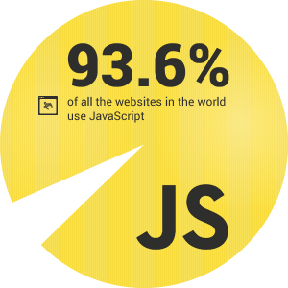
What is JavaScript? (2)
Almost anything a web page does besides displaying static content will use JavaScript
Notes:
JavaScript is broadly used. One estimate is that over 93% of all websites use JavaScript. Almost anything a web page does besides displaying static content will use JavaScript. If you want to experience a broken web, disable JavaScript in your web browser, and then explore what you can and cannot do.

Slide 71
Web Languages Summary
The main web languages are HTML, CSS, and JavaScript
  display content to the user
  allow the user to interact with web data
HTML provides the content and structure of a web page
  HTML uses tags that a browser interprets
CSS defines the look and feel part of a web page
  Adds styles to HTML tags
JavaScript controls the behavior of web pages
  Allows users to interact with a web page
Notes:
In summary, there are three primary languages used by the web, which are HTML, CSS, and JavaScript. Each language makes up a specific part of a web page. Their primary purpose is to display content to the user and allow the user to interact with web data. First, HTML provides the content and structure of a web page. HTML is a markup language that uses tags that a web browser interprets. Next, CSS defines the look and feel of the web page. CSS rules add styles to HTML tags, such as color and font size. Finally, JavaScript controls the behavior of the web page and allows users to interact with the web data. Anything that a webpage does besides displaying static content will use JavaScript.

